Slide 1

Bundaberg eSports FIFA Web App
IA2 Project; Prototype
Digital Solutions
Paddy Maher

Slide 2
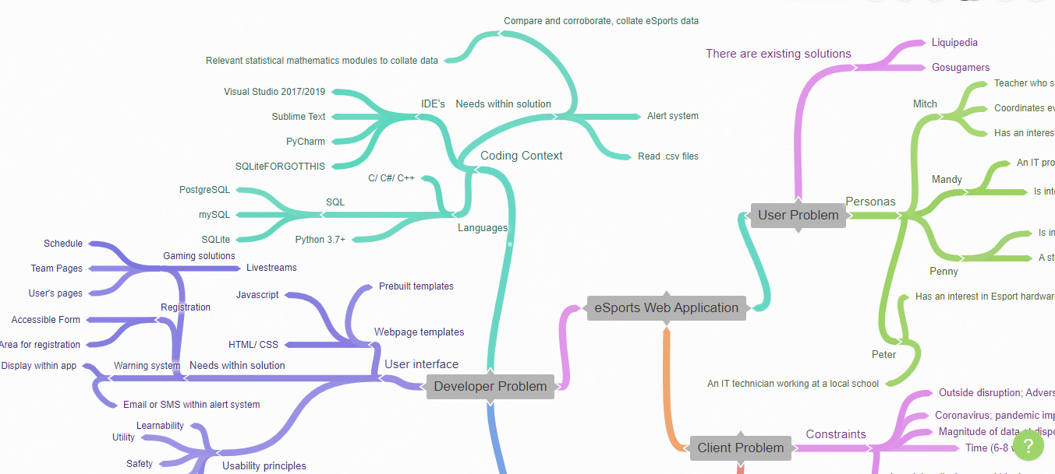
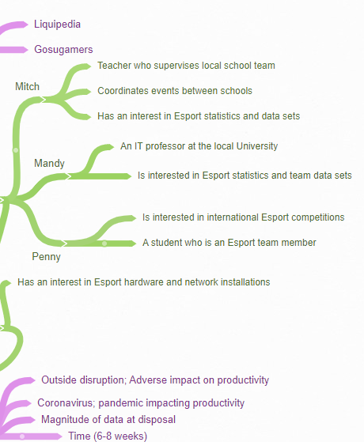
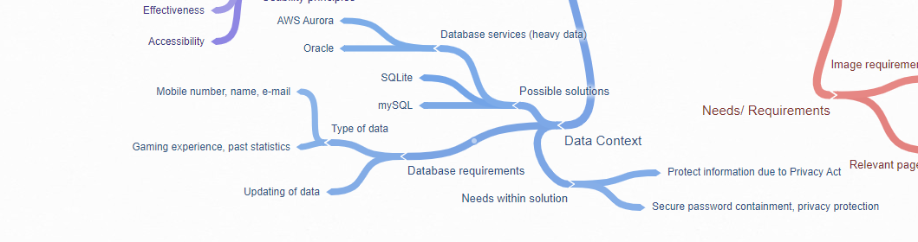
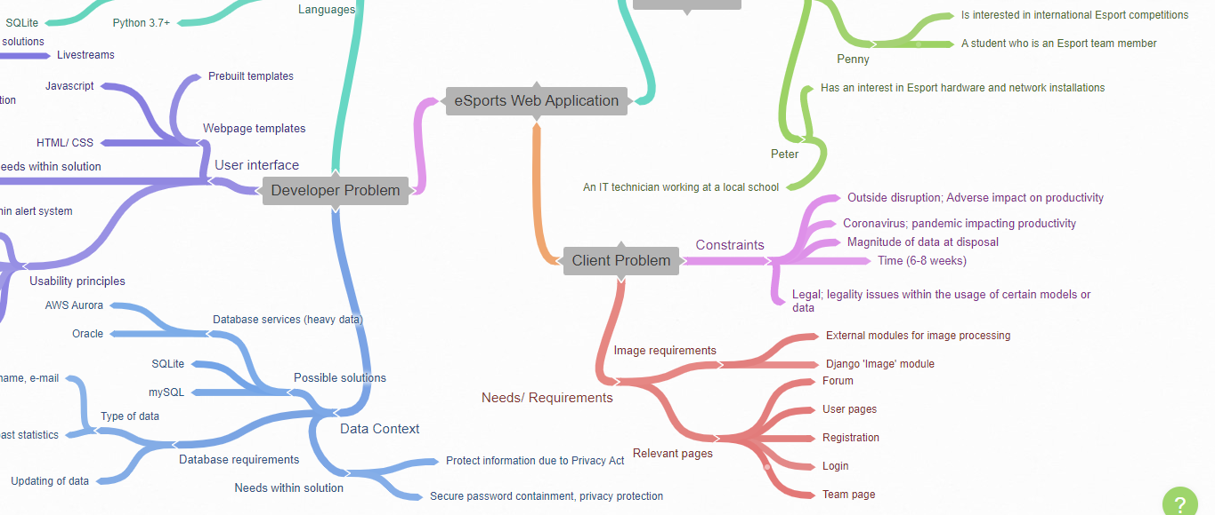
Explore- Identification of criteria

Slide 3
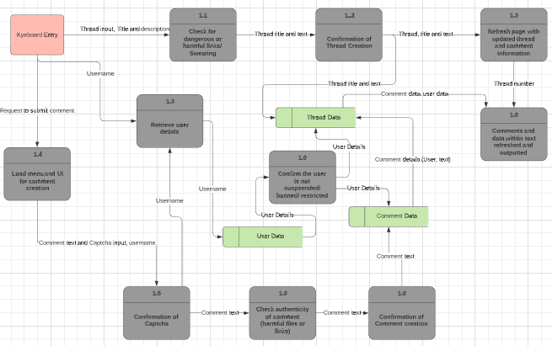
Development- Solution overview and Criteria
PC(n) and SC(n) refer to the nth element of either the Prescribed Criteria or Self Prescribed Criteria
Prescribed Criteria;
Recognise and describe programmed and UI components with accessibility, useability, effectiveness, safety, utility and learnability
Symbolise developer problems using mind maps or ER diagrams, interrelationships between user experiences and data
Explain internal and external data components using appropriate symbols, code and data samples. How elements in user-interface connect in annotated diagrams
Analyse prototype web application and information to identify data inputs, data and programmed components and their relationships, prototype’s personal, social and economic impacts
Determine solution requirements that include; essential elements on useability principles, data structures and linkage to interface and code
Synthesise ideas and information about solutions for UI, data and programmed components of the prototype, data repositories and programming to generate a prototype web app
Generate sample code for 4-6 A4 pages demonstrating selection, iteration, user input and data output- a prototype web application by combining the UI, data and coded components
Evaluate against criteria personal, social and economic impacts supported by a collection of data samples or representations. Accuracy and efficiency of coded components in tables, diagrams and paragraphs
Make refinements and recommendations for current and future improvements
Self-Prescribed Criteria;
Compile relevant eSport into data repositories to be accessed through a prototype web application
Gain insight on the audience within FIFA eSports and how visual communication elements can be manipulated to optimise traffic for a web app
Understand how existing solutions have developed their web apps with relevant code and UI components
Generate a web app using relevant front and back-end codes using web frameworks such as Django
Adapted for the Bundaberg community
Alert system including notifications and emails
Constraints
Time; 6-8 Weeks
Legal; components within data usage may have legality issues
Coronavirus; pandemic impacting productivity
Outside disruption; adverse impact on productivity
INPUT
PROCESS
OUTPUT

Slide 4
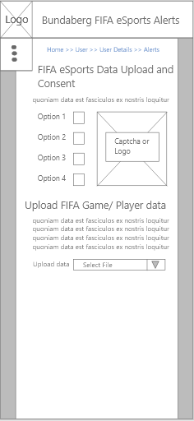
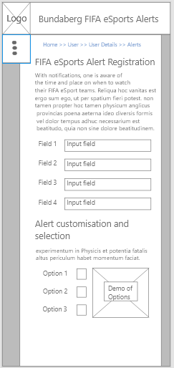
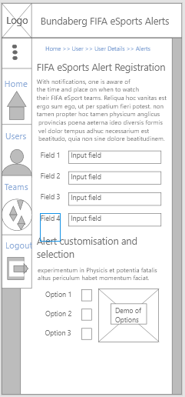
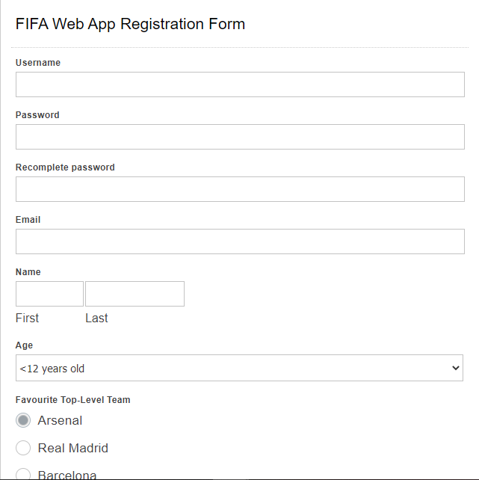
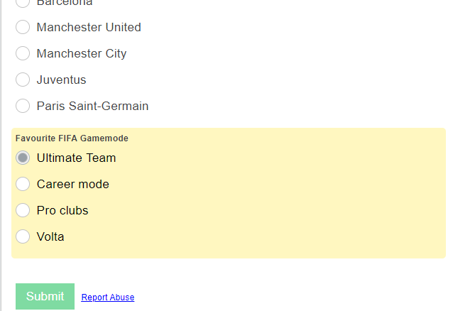
Development- User Interface
Banner and logo
Use of breadcrumbs, three circles to signify opening of menu
Banner and logo with username and password fields. These fields use the visual communication element of alignment with the visual communication principle of proximity.
The retyping of the password is common within registration pages as retyping the password strengthens the memory the user will have with the password.
Email and First name are also common, and can link a person to an accounts. This is particularly useful for eSport professionals, who wish to spread their name and can get contracts through e-mails, thus making the FIFA Web app more suitable for professional FIFA eSports, Age is also important for professional eSports and may be used for safety functions. Age, unlike the previous fields use a scroll=down menu for options.
Multiple-choice fields are used within characterisation for creation of the FIFA follower’s account. Options such as ‘favourite top team’ and ‘favourite FIFA gamemode’ give the option of using algorithms for users to access an environment more suited to their likes and with people with similar tastes, thus making it more likely for users to stay on the site.
User consent, acknowledgement of copyright and privacy principles associated with data upload and alert registration
Universal symbols of common webpages within a web app
Disclaimers and descriptions for users within options and forms
Image to demonstrate a given option within a form
Selection box, multiple-option
The above wireframes demonstrate visual communication elements and principles in the form of alignment and placement of the entities within the page. Boxes for entering fields and affirming Boolean values are evenly spaced throughout the page, attributing to useability and learnability within the page
Text coloured blue indicates hyperlinks
COMMENT CREATION FUNCTION
SITE MAP
THREAD CREATION FUNCTION
Through creating templates with elements of breadcrumbs, site maps are integral in indicating the paradigm of the web app. Whilst there are more to added to this site map seen to the right, this site map indicates all front-end elements that hold functions. Understanding the relationships between entities is important within the developer view, and helps to understand how a user interacts within the app.
Outlining the site map also indicates the significance of navigation throughout a given web app, as the greater the complexity of the site map, the more useability and learnability techniques should be used
eSports Forum
Comment creation form, Data upload
eSports Forum
Thread site
Home page
Data presentation
eSports Team Page
eSports Team Schedule
Data repository
This form was created with wufoo (https://www.wufoo.com/)
eSports Alert Registration
CREATE ALERT FUNCTION

Slide 5


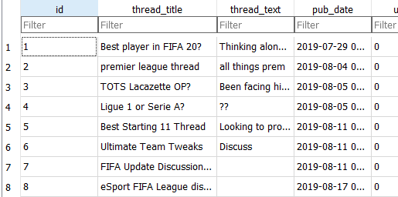
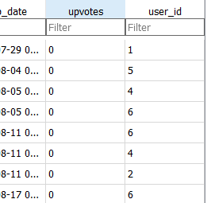
Development- User Interface and Data
DELETE FROM User WHERE ‘id’ = 1
INSERT INTO User VALUES( 25,’Frederich’, ‘FIFA Team 1’,’13’,
’Beyond_Good_And_Evil@outlook.com’ );
This data has been checked for data integrity in order to prevent data redundancy.
Redundant data can come in the form of;
Two fields being the same
Data being unreadable or not within format of the SQL table (input constraints)
Null values in fields that are not meant to be null
Data types different to that specified within the field
The ‘CREATE’ SQL statement is used for creating a model within an SQL server. Within an SQL statement, fields are initialised first through their names, and then characterised through various keywords that describe their data type. For example, the ‘username’ field is written with the name of the field ‘username’, followed by it’s datatype ‘VARCHAR’, with the amount of text within the field (20), followed by the requirement for the data not to be null.
https://www.w3schools.com/sql/sql_create_table.asp
Other statements can be used to manually insert and remove entries and fields within a table such as ‘DELETE’ and ‘INSERT INTO’.
(INSERT INTO)
https://www.w3schools.com/sql/sql_create_table.asp,
(DELETE)
https://www.w3schools.com/sql/sql_delete.asp
CREATE TABLE User {
id integer NOT NULL UNIQUE PRIMARY AUTOINCREMENT,
username varchar(20) NOT NULL,
team_following varchar(30) DEFAULT NULL,
wins integer DEFAULT NULL,
email varchar(30) NOT NULL,
};
For a developer working through SQL within web apps, SQLite is a light-weight iteration of SQL similar to MySQL and PostgreSQL thus making it appealing particularly within prototyping databases. Within development of SQLite servers, SQLite Database Browser provides a way to access these databases with easy implementation of SQL commands.
https://sqlitebrowser.org/
The MySQL and SQLite use AUTOINCREMENT. This is used as it indicates the database automatically creates these fields within a given model as default. Usually this refers to the ‘id’ of a given object.
https://www.w3schools.com/sql/sql_autoincrement.asp
The various data types within this table are;
‘ID’:INTEGER
‘THREAD_TITLE’:VARCHAR
‘THREAD_TEXT’:VARCHAR
‘PUBDATE’:DATETIME
‘UPVOTES’:INTEGER
‘USER_ID’:INTEGER
The table as seen on the bottom right is the ‘main/thread’ (<< NOT THE NAME CHANGE) table and is used for displaying the threads within the FIFA eSports Forum. Users register data in this table through forms and fields are inputted by users such as ‘thread_title’ and ‘thread_text’. However fields such as ‘id’,’user_id’ and ‘pub_date’ are completed automatically on creation of the thread object.
The threads for displaying are called using a Foreign Key to the Thread model.
Foreign Keys will be used also for other functional components necessary to an eSports app such as an alert system. The implementation of these Foreign Keys and not keeping all models and information confined to one table retains data integrity.
Data within this table will be deleted in seven days. There are various reasons;
Seven days is enough to collect a week of FIFA eSports discussion and is useful for information to optimise the Web app’s function
The data cannot stay indefinitely to retain the privacy of the users
The website and development could be updated and there is a risk the data will become redundant
Most recent data is typically most relevant as it describes the current interests of the FIFA Web app user’s interests

Slide 6
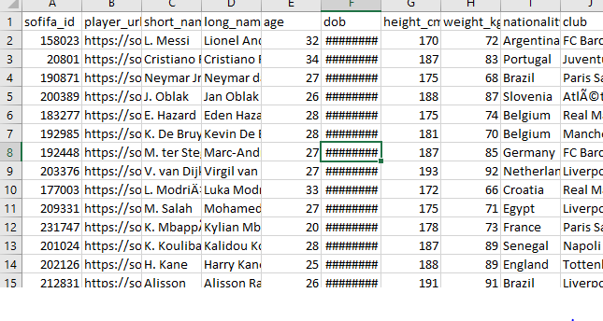

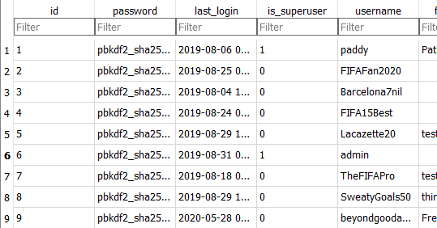
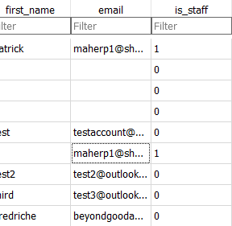
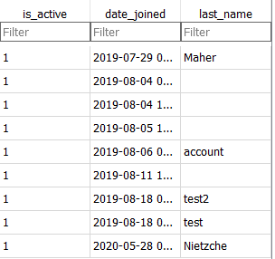
Development- Data 1
This diagram describes how the models relate to each other with Foreign Keys and particularly one-to-many relationships.
THREAD
COMMENT
There are methods of exporting .csv to SQL or SQLite such as with USBWebserver and phpMyAdmin
https://www.sqlshack.com/importing-and-working-with-csv-files-in-sql-server/
PK; THREAD_ID; INTEGER,
THREAD_TITLE; VARCHAR(30),
THREAD_TEXT; VARCHAR(50),
PUBDATE; DATETIME,
UPVOTES, INTEGER,
USER_ID, INTEGER
PK; COMMENT_ID,; INTEGER,
COMMENT_TEXT; VARCHAR(50),
PUB_DATE; DATETIME,
UPVOTES; INTEGER,
THREAD_ID; INTEGER,
USER_ID; INTEGER
USER
PK; USER_ID; INTEGER,
PASSWORD; VARCHAR(50),
USERNAME; VARCHAR(30),
EMAILL VARCHAR(40),
IS_STAFF; BOOLEAN,
IS_ACTIVE; BOOLEAN,
DATE_JOINED; DATETIME,
FIRST_NAME; VARCHAR(20),
LAST_NAME; VARCHAR(20),
IS_SUPERUSER; BOOLEAN
And if data is viewed to be redundant, it can be deleted through SQL;
DELETE FROM TABLE Users
FIELD ‘is_Staff’;
(https://www.w3schools.com/sql/sql_delete.asp)
ALERT
PK; ALERT_ID,; INTEGER,
ALERT_TEXT; VARCHAR(50),
PUB_DATE; DATETIME,
USER_ID; INTEGER
This table outlines the ‘User’ model. Within this model, various datatypes are inputted ranging from Booleans (for ‘superuser’, ‘is_staff’, etc), varchar (for various fields such as username and email), integer (‘id’)m and datetime (‘date_joined’).
Data can be stored within Excel .csv files and through data upload methods, large sums of data can be transferred. This also accounts for downloading open-source csv files for easy data that can help optimise the FIFA Web App.
Data can be inputted within this SQL server through insert commands (https://www.w3schools.com/sql/sql_insert.asp#:~:text=INSERT%20INTO%20Syntax,%2C%20column3%2C%20...))
ALTER TABLE Users
ADD
FIFAWins integer,
FIFALosses integer;
Related eSport components can always be added through the SQL ‘ALTER’ statement.
http://w3schools.com/sql/sql_alter.asp
INSERT INTO User VALUES(
‘password’, ‘0’,
’beyondgoodandevil’,
’Fredriche’,
’beyondgoodandevil@outlook.com’,
’0’,
’Nietzche’);

Slide 7
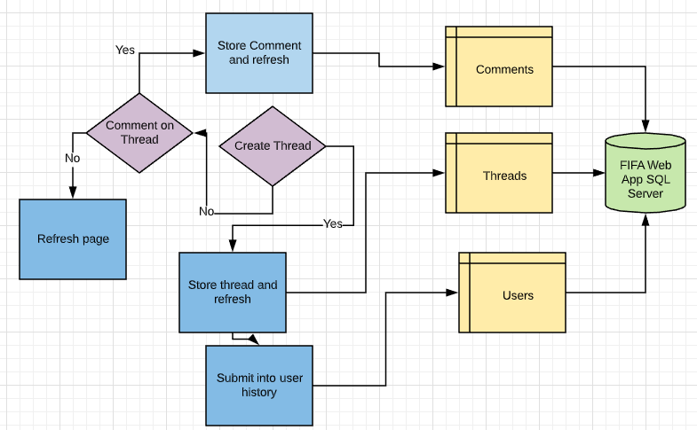
Development- Data 2
ALTER TABLE main_additionaluserinfo {
“FifaGoals” integer DEFAULT = “0”,
“FifaYellowCards” integer,
“FifaRedCards” integer,
“FifaLeaguesWon” integer};
INSERT INTO TABLE main_additionaluserinfo
VALUES {‘5’,
’UltimateTeam’,
’2’,
’[Image]’,
’23’,
’50’,
’2’,
’6’};
CREATE TABLE main_additionaluserinfo {
“id” integer NOT NULL PRIMARY KEY AUTOINCREMENT,
“pc” integer NOT NULL,
“user_id” NOT NULL UNIQUE REFERENCES,
“image” varchar(100) NOT NULL};
CREATE TABLE main_thread { “id” integer NOT NULL PRIMARY KEY AUTOINCREMENT, “thread_title” varchar(50) NOT NULL,
“thread_text” varchar(200) NOT NULL,
“pub_date” datetime NOT NULL,
“upvotes” integer NOT NULL, “user_id” integer NULL REFERENCES “auth_user”(“id”) DEFERRABLE INITALLY DEFERRED};
CREATE TABLE main_comment { “id” integer NOT NULL PRIMARY KEY AUTOINCREMENT, “comment_text” varchar(20) NOT NULL,
“pub_date” datetime NOT NULL,
“upvotes” integer NOT NULL,
“thread_id” integer NULL REFERENCE “main_thread”(“id”) DEFERRABLE INITIALLY DEFERRED,
“user_id” integer NULL REFERENCES “auth_user”(“id”) DEFERRABLE INITALLY DEFERRED};
CREATE TABLE auth_user {“id” integer NOT NULL PRIMARY KEY AUTOINCREMENT,
“password” varchar(128) NOT NULL,
“last_login” datetime,
“is_superuser” bool NOT NULL,
“username” varchar(150) NOT NULL,
“first_name” varchar(30) NOT NULL,
“email” varchar(254) NOT NULL,
“is_staff” bool NOT NULL,
“is_active” bool NOT NULL,
“date_joined” datetime NOT NULL,
“last_name” varchar(150) NOT NULL};
The following ‘CREATE’ SQL tables command contain four of the prominent models in the Bundaberg FIFA Web App. The first of these demonstrated is “main_additionaluserinfo” table. A custom-made table for adding to the ‘User’ modelIt’s first field is autogenerated (as indicated by the ‘AUTOINCREMENT’ statement) by Django and SQLite as the ‘id’ field. This is found within each of the tables as the primary key. The “user_id” in addition to being ‘NOT NULL’ is registered as ‘UNIQUE REFERENCES’ indicated this field is referenced within other models. This referencing is integral to formation of foreign keys and is unique in Django as the convenience for creation of foreign keys is notable.
A pivotal SQL command is the creation of the app through the ‘Create database’ command
Create database “BundabergFIFAeSports”
This code describes how FIFA components can be inputted to the table with values following this. ‘ALTER’ is often using more than ‘CREATE’ due to constant changing in development and generation of a given digital solution as described by the EDGE process
Following the “main_additionaluserinfo” table is the basis of the Bundaberg FIFA Web App’s Forum, “main_thread”. Similar to the “main_additionaluserinfo” table, the “main_thread” is custom-generated. It contains two text options in the title and text allowing all characters via the ‘varchar’ datatype. ‘datetime’ is used for the publication date field ‘pub_date’. The thread is linked back to the user using the ‘REFERENCES’ to the table “auth_user”, requesting the field “id” for the “user_id”. This is initially deferred via the SQL statement “DEFERABBLE INITIALLY DEFERRED”
The below ER Diagram describes the logical flow of various systems within the Bundaberg FIFA eSports Web app in particular the Forum system. Through decisions on events such as creation of threads and comments can different events be fired and tracked to internal storages and eventually the SQLite server
In serving a similar purpose to the ‘thread’ model in the paradigm of the web app, the ‘comment’ model subsequently has a similar data store. It retains most of the same fields as ‘main_thread’ despite not having a title, however ‘main_comment’ links to the thread itself as a foreign key. Similar to how ‘main_thread’ links to the ‘User’ model via the ‘user_id’ and it’s table ‘auth_user’, ‘main_comment’ links to the ‘Thread’ model via the ‘thread_id’ and it’s table ‘main_thread’. It also links back to the user, allowing users to upvote and create threads and comments alike.
The likely most prominent model initialised is the ‘User’ model. Unlike the previous three tables (“main_additionaluserinfo”, “main_thread”, “main_comment”) which were custom-made, the ‘User’ model is a Django generated table. This difference in development is reflected through the SQL table. Using a different datatype as seen from before, “bool” can be seen to be used for three fields (“is_superuser”, “is_staff”, “is_active”). Bools are binary functions in that they can only be true or false. Although “is_superuser” and “is_staff” can seem to be similar and do serve similar purposes within Django admin, Django provides more choices to developers on which field to use. Many other standard fields for User creation can be seen in this table such as “password”, “username”, “email”, “first_name” and “last_name”. However it must be noted that (as in the previously data slide’s table representing this SQL table) the password data is encrypted.

Slide 8
Development- Algorithms
The registration algorithm begins by gathering the data from the UserForm. The algorithm goes on to check whether this data is double data (already within database) and inputs to the database if it tests negative to already being in the database.
Algorithm for registration (Add Users)
GET * FROM UserForm
IF username IN TABLE Users
  THEN Redirect
ELSE
  INPUT INTO TABLE Users { username, password, email, first_name, last_name }
  LOGIN USER
  Redirect
Algorithm for processing Comments
SELECT FROM TABLE ‘main.comments’
FOR
FOR EACH thread;
IF ‘comment.user’ banned THEN
NOT display thread
ELSE IF ‘comment.image’ NOT appropriate THEN
NOT display thread
  ELSE IF ‘comment.text’ NOT appropriate THEN
  NOT display thread
ELSE display.thread
Algorithm for FIFA ranking
IF User.Goals <10 THEN Rank = ‘Bronze’
ELSEIF User.Goals <50 THEN Rank = ‘Silver’
ELSEIF User.Goals <200 THEN Rank = ‘Gold’
ELSEIF User.Goals <500 THEN Rank = ‘Platnium’
ELSEIF User.Goals >500 THEN Rank = ‘Masters’
Through the submission of information by the user such as their favourite Football/ Soccer Team, algorithms such as this match these users to other users of the same favourite team, thus they will find the site more user-friendly to their interests. This algorithm iterates through users and inputs them into tables characterized by their favourite team. More algorithms could be used to use this data to increase the probability of users in each table to interact with eachother.
Algorithm for processing Threads
SELECT FROM TABLE ‘main.threads’
FOR EACH thread;
IF ‘thread.user’ banned THEN
NOT display thread
ELSE IF ‘thread.title’ NOT appropriate THEN
NOT display thread
  ELSE IF ‘thread.text’ NOT appropriate THEN
  NOT display thread
ELSE display.thread
Algorithm for triggering Alerts
Create list of events within FIFA Web app that has cause to trigger a user;
LIST : [New_FIFA_Update, FIFA_Web_App_Update, Force_Update, User_Banned_or_Suspended]
Check if a given event is within the list
IF event IN LIST THEN
CREATE NewAlert
IF event = {New_FIFA_Update} SET warning LOW
ELISEIF event = {FIFA_Web_App_Update} SET warning MEDIUM
ELSEIF event = {Force_Update, User_Banned_or_Suspended} SET warning HIGH
This algorithm processes the creation and the validation of the ‘Thread’ model, that is the key model for the discussion forums Within this pseudocode algorithm, conditional statements ‘if’ and ‘then’ check if the user is banned or if the content they have provided is appropriate
Algorithm for matching interests
GET * FROM User TABLE
  FOR user in User TABLE:
  GET ‘favourite_team’ from user
  INPUT user INTO {‘favourite_team’} TABLE
The FIFA Web app comment algorithm is similar to the thread algorithm, checking if the user is banned and if the comment’s data (text and image) is appropriate. In the case the data is appropriate and the user is not banned, the comment is outputted.
Algorithm for validating email
IF User.Registered = True
GET FROM User TABLE User.Email
SEND Verification_Email to User .Email
The FIFA Web app employs an alert system. Using a list of possible events that warrant an alert, the algorithm deciphers whether the event permit an alert using a conditional statement. An alert is created with varying levels of significance, represented by warning level, depending on which event is inputted to the algorithm.
Within the FIFA eSports Web app, emails will be sent in order to test the validity of the email inputted by a user registering in the UserForm.
Similar to matching interests, users can also be categorized by their skill in FIFA, in this case being determined by the amount of career goals scored. This algorithm retrieves the user’s amount of goals and sets a list of goal requirement for different ranks varying from ‘Bronze’ to ‘Masters’.

Slide 9
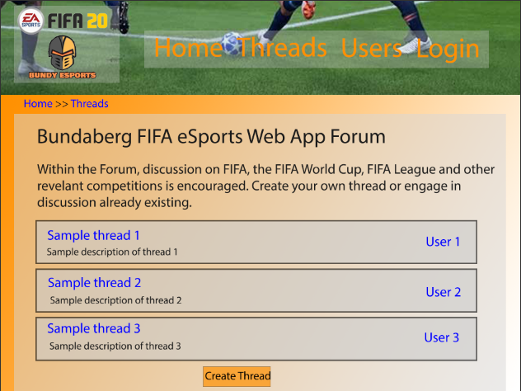
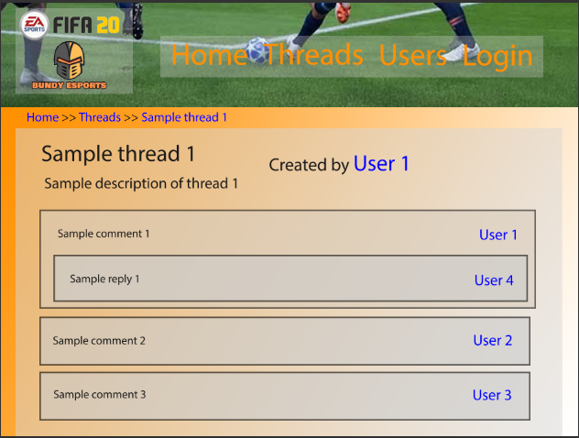
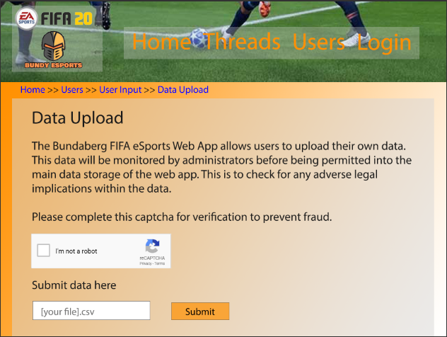
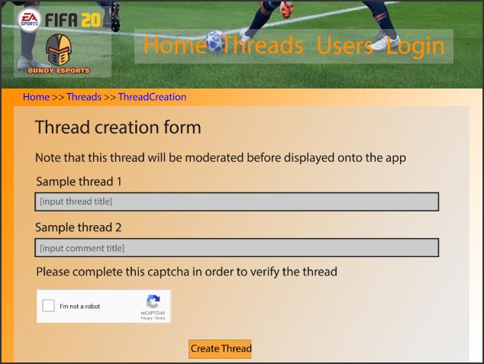
Generate- User interface (HTML code)
The ‘/threads’ page is the basis of the Bundaberg FIFA eSports web app forum which consequently has mass social, economic and personal impact on the Bundaberg FIFA community. A title followed by a description is listed at the top in black to contrast the orange and white gradient background. Following this, thread models are displayed via boxes with the blue thread titles indicating links. Alongside this is the thread description and the user whom created the thread, which also has a link. The thread page also has an option to create a thread which will link to the ThreadForm through the URL ‘/threads/CreateThread.html’
/threads
/threads/Sample_ thread_1.html
The data upload is important for collecting FIFA data and thus making the site better for this. A captcha is used to prevent mass botting of data upload. The data is accepted at the bottom through .csv files. A disclaimer is also given stating moderators will check data before officially uploading it to the main database.
The thread creation form uses alignment for fields combined with a captcha for data security.
This HTML page demonstrates the view inside one of the threads. As seen here the ‘thread_title’ and ‘thread_text’ seen in the URLS ‘/threads’ and ‘/threads/CreateThread.html’ are at the top of the page. Below this are comments, with their respective comment texts and the user linked. A reply to a comment can also be seen within the first sample comment.
The navigation bar is integral for the useability and learnability of the web app. The leftmost of the navigation shows the FIFA 20 Logo and the Bundaberg eSports logo. To the right of this are the relevant main pages with a backdrop of a FIFA image. The translucent backdrops of the texts and logos make the text readable without obstructing on the image.
/users/UserInput/DataUpload.html
/threads/CreateThread.html

Slide 10
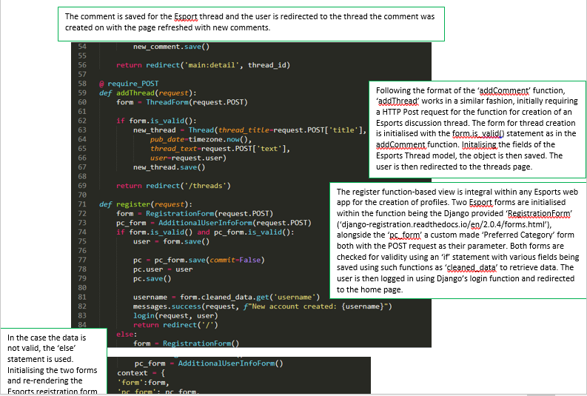
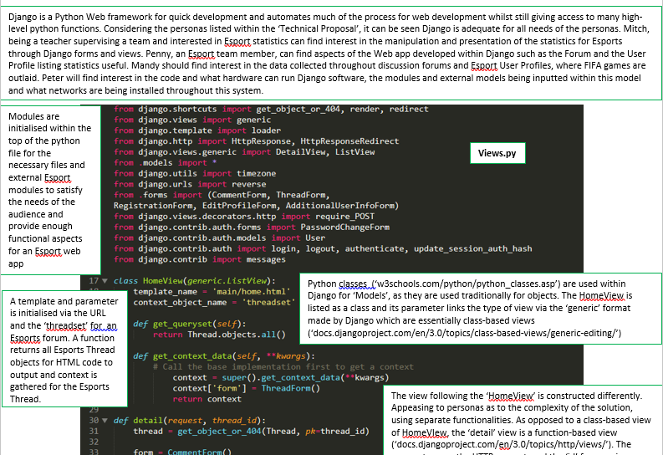
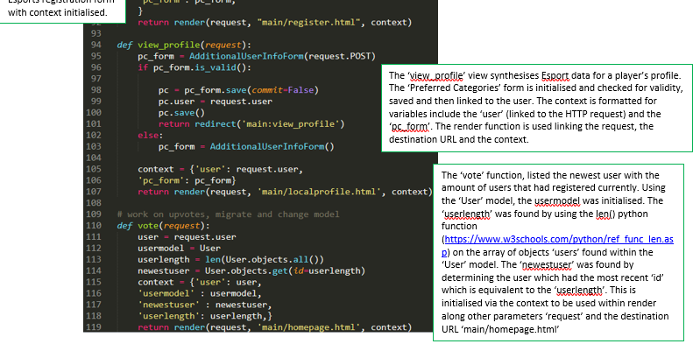
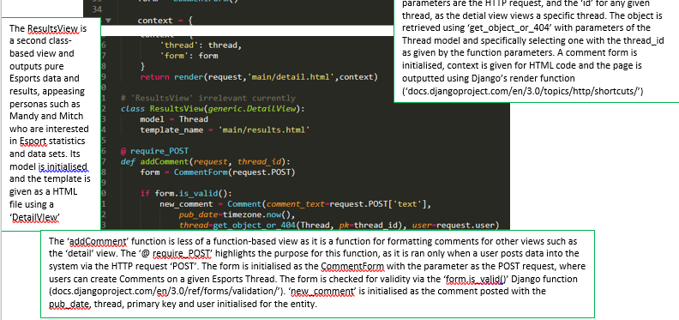
Generate- Code

Slide 11
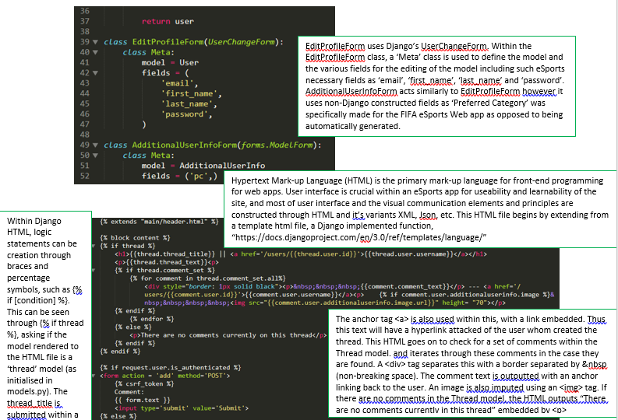
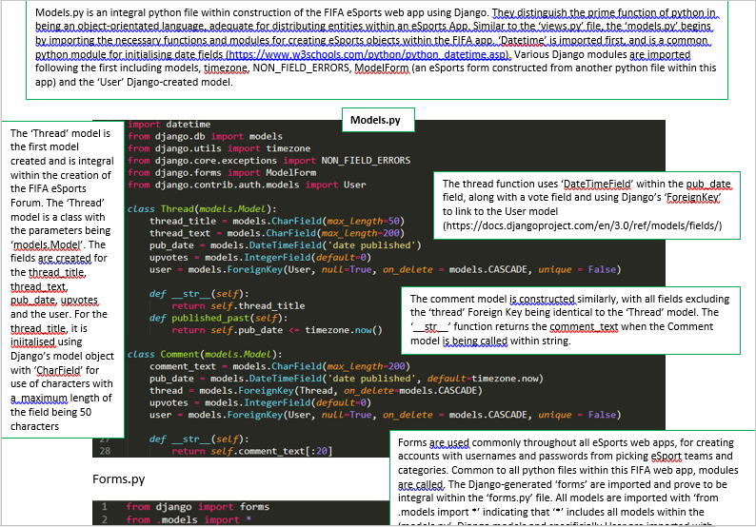
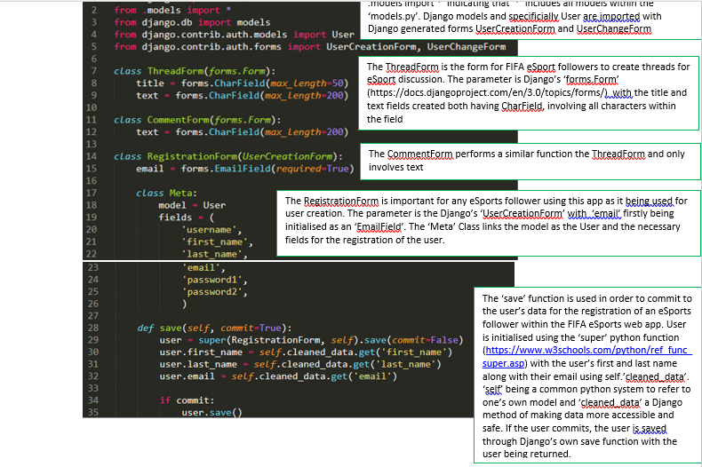
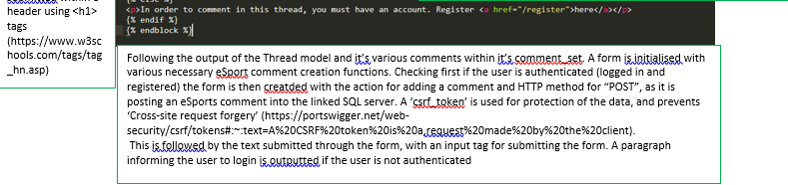
Generate- Code

Slide 12
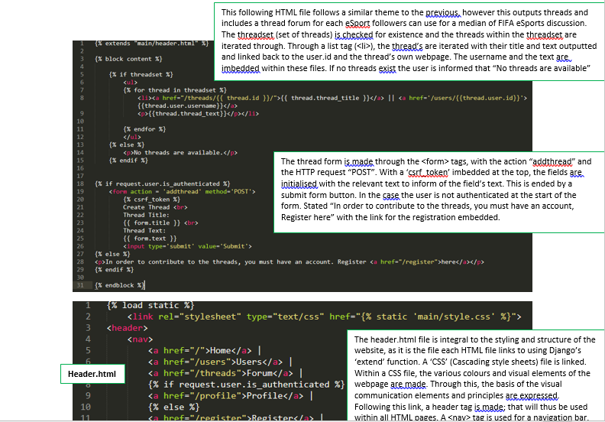
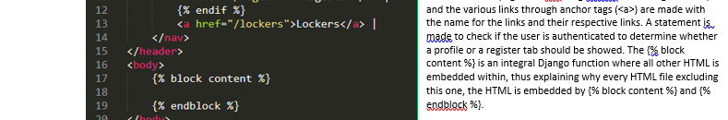
Generate- Code

Slide 13

Evaluation and References- Impacts
References
Djangoproject.com. 2020. The Web Framework For Perfectionists With Deadlines | Django. [online] Available at: <https://www.djangoproject.com/> [Accessed 4 June 2020].
Lucidchart.com. 2020. Lucid Chart. [online] Available at: <https://www.lucidchart.com/pages/> [Accessed 4 June 2020].
Professional forms solutions for you by Zigaform. 2020. Portfolio - Professional Forms Solutions For You By Zigaform. [online] Available at: <https://zigaform.com/> [Accessed 4 June 2020].
W3schools.com. 2020. W3schools Online Web Tutorials. [online] Available at: <https://www.w3schools.com/> [Accessed 4 June 2020].
Wufoo. 2020. Online Form Builder With Cloud Storage Database | Wufoo. [online] Available at: <https://www.wufoo.com/> [Accessed 4 June 2020].
Social, Personal, Economic and Legal Impacts (PC4)
Social
The Bundaberg FIFA eSports web app was designed for the purpose of the uniting the FIFA eSports community and thus the social aspect of the app is integral to it’s function. Features such as the forum are designed entirely for social purposes, encouraging users to discuss FIFA related topics through thread and comments. Profiles are made for users to express themselves and interact with other user’s profiles. This will be suitable for personas such as Penny who enjoys eSport discussion and competitions. Thus this site can be deemed to be socially adequate.
Personal
Within all stages of the EDGE process (explore, develop, generate and evaluate) in creation of the web app, UI and the user experience was considered. Knowledge on visual communication elements and principles attributed to the accessibility, useability and learnability of the site. The features that users were given access to also attribute to the site’s appeal. With personas such as Mitch and Mandy being able to find interest in the data sets created through such feature as the forum or the data upload. Within data upload, there are algorithms and built in functions to store data in a safe way that respects the privacy of the user, using such Django functions as ‘cleaned_data’.
Economic
With the rise of eSports as entertainment, it comes with larger prize money and larger potential for business ventures. Businesses increasing more often have been seen to take interest in eSports such as FIFA with the introduction of FIFA Leagues and the FIFA World Cup. Thus the Bundaberg FIFA Web App can serve as a platform for Bundaberg eSports and the business potential that comes with it. Through player profiles, data upload and team schedules, the Bundaberg FIFA Web app is adept for major business potential.
Legal
The data used within the Bundaberg FIFA Web App was open and public data, and the modules and necessary external components used to create the prototype was open source.
Prescribed Criteria (PC) and Self-Prescribed Criteria (SC) Checklist
Must have 7 days of FIFA related data such as player goals, assists, wins, losses, penalties (SC1)
Must have 7 days of Web app related data such as forum data (threads and comments), user details, images (SC1)
A data upload system for .csv and other files storing masses of data (SC1, PC5)
An alert system that sends notification sufficient to the magnitude of the event warranting an alert (SC6)
Clear site navigation system for easy access and learnability (PC1, PC2)
Construction of website through the use of data to gain information on the social and economic requirement and wants of the target audience for the Bundaberg FIFA eSports web app (PC8, SC2)
Efficient and learnable code that implements complex functions yet necessary for the Bundaberg FIFA eSports web app (PC7, SC3, SC4)
Allowance of users to upload data and share data such as comments, threads and images (SC1)
Visual communication elements and principles displayed within constructed of Bundaberg FIFA eSports web app UI (PC1, PC6, SC3)
Create appropriate diagrams such as DFDs, ER Diagrams and prototype UI designs to help in development stage (PC2, PC5, PC6)
Constraints
Assignment finished within time frame and considering restraints such as Coronavirus and separate outside disruptions
Assessed many accessibility standards and criteria through all stages of the EDGE process within developing the prototype Bundaberg FIFA web app (Explore, develop, generate, evaluate)
All data used and uploaded was within legal limits and was done within fair use policies
Completion Criteria (To-do list)
Create Thread and comment construction; eSports discussion forum
Use Relevant modules used for Bundaberg FIFA audience
Create Admin/ Superuser field for testing and easy access to update
Use FIFA eSport related data, fields for input and data upload
Use the Django-exclusive features that minimise development
Create UI’s considering accessibility, useability and learnability
Create relevant fields for user registration and profiles such as ‘username’ and ‘password’
Generate code to register and store data inputted by users through generated forms
Create an alert system for users with varying settings
Create method for the encryption and decryption of data to respect privacy of users

Slide 14
Evaluation- Testing and Recommendations
Further Recommendations
Despite the completion of the prototype, it is evident that there is potential for many of the functionalities and aspects to be improved or extended upon. Although the prototype showed to have many integral features within many web apps such as users, registration/login and a forum, there is much eSport and FIFA related content that can yet be added.
An eSport feature that is common within eSport hubs online is a streaming feature. Using modules from ‘Twitch’ or other streaming platforms would attribute to the eSport experience. This could be added upon with a live chat for users to collaborate in the midst of an eSport event. Whilst explored, the app never solidified the concept of adding eSport ‘team pages’ for FIFA Professional eSport gaming teams. Team pages can be customisable and much access can be given to other team developers. Schedules can be implemented for the competition along with ladders and tables with live scores. The implementation of these eSport companies and teams would attribute greatly to the Economic factor of the Bundaberg FIFA Web app.
There are also many FIFA specific components that can be added. FIFA, being a constantly updating and changing game with data such as player statistics and league expectations being changed regularly, there could be more standardised output of this data within the Bundaberg FIFA Web app. As opposed to leaving this discussion to the forum, official pages such as ‘FIFA Updates’ could be implemented.
More connection to Bundaberg was needed. This could be done by locating an area for meeting development and maintenance of this site in Bundaberg along with a map located on the home page.
Event/ Action | Theoretical Output | Actual Output | Improvements/ Extensions
Test inserting models such as threads, comments and users | Models should be inserted into SQL table and should be outputted as normally | Worked as expected
Test registering a user | All fields such as username, first_name, last_name and password should be inputted into the SQL table along with password being encrypted | Worked as expected, with the addition of Django’s auto-generated ‘id’ column | The password encryption could be used from an external source
Test adding a thread via the ThreadForm | The fields should be transferred via the python code to the SQL table and the page should refresh with the new table | Worked as expected
Test uploading images | The Image should be filed into a datastore and be rendered within HTML code to display to the front-end | Worked as expected | Unreliable as only a flat-file database used for this. A larger more reliable database is needed
Test attempting to reach admin controls with a non-admin account | The user should be denied of access | Worked as expected, within the Django admin panel | A more customised admin panel could be implemented, more suited to the FIFA Web app
Test the hyperlinks and various URLs | The links direct the user to the correct page, with the correct text and titles displaying links | Worked as expected | Make links more clear as a link, blue underline is often universally accepted as a link
Test adding a comment via the CommentForm | Similar to the ThreadForm, the fields should be transferred via python to the SQL table, the page should refresh with the comments rendered | Worked as expected
Test inserting a thread with no fields | The thread is not added | Thread was added with autogenerated ‘id’ and null for all nullable fields | Implement a requirement for one or more fields to be NON-NULLABLE in the Thread Model
Accessibility Checklist
A clear navigation bar that gives access to tabs such as ‘Users’, ‘Home’ and ‘Threads’
Forms are correctly aligned for greater useability and learnability
Clear borders used for objects such as threads and comments
Colour contrast between text and background
Links describe the URL location accurately and efficiently
Colour not used to display information (body text is not coloured)
Text size can be manipulated and augmented by the user
Fields that are mandatory are indicated to be so (Fields that are ‘NON NULLABLE’ within the SQL Table)
Users can customise their profile with a profile image
Breadcrumbs are implemented to assist with navigation for the useability and learnability of the site
Multiple files can be uploaded such as .csv files
Labels are positioned close to the information related
There is equal proximity between most/ all objects within any given web page
URLs are readable, easy to interpret and navigate
Alerts are readable and have adequate settings for the magnitude of the error
The Bundaberg FIFA eSports Web App main colours can be seen throughout all the app’s UI components

